Slide 1

WHAT WAS THE Iroquois confederacy?

Slide 2
What are we learning?
This chapter explores the social structure of Iroquois society, which showed particular respect for women and for people of other cultures.
It also explores the structure and processes of Iroquois government. Think back to Chapter 3, where you saw how the social structure of ancient Athens determined the way people participated in its government. In this chapter, you will learn about the roles and responsibilities of people in the Iroquois Confederacy.
Notes:
Understand that the Iroquois Confederacy is made up of separate nations, bound by the Great Law of Peace, and that it is many centuries old. It still exists today.

Slide 3
WHY ARE WE LEARNING THIS?
Just like buildings and roads, ideas have roots in the past. The ideas that shape Canada’s government today reflect ideas from other, older societies, such as the Iroquois Confederacy. By exploring the Confederacy, we are exploring ideas that affect us today
Ideas such as equality, consensus and respect for diversity. We can learn more about them and discover how they influenced democracy.

Slide 4
IROQUOIS vs. HAUDENOSAUNEE
There are two names for the Iroquois people today: Iroquois (ear-o-kwa) and Haudenosaunee (how-den-o-show-nee).
Iroquois is a name that dates from the fur trade during the 1600s. The French learned this name from the Ouendat (wen-dat), an enemy nation of the Iroquois.

Slide 5
IROQUOIS vs. HAUDENOSAUNEE
Haudenosaunee is what the people call themselves in their own language. It means “people of the longhouse” and comes from the name for the people’s traditional dwelling.
How do the names Iroquois and Haudenosaunee reflect the different perspectives of peoples?
How do they reflect the history of North America?

Slide 6
HOW DID THE IROQUOIS CONFEDERACY BEGIN?
Five different nations founded the Iroquois Confederacy:
Seneca (Sen-e-kuh)
Cayuga (Ky-you-guh)
Onondaga (On-on-da-guh)
Oneida (O-nee-duh)
Mohawk (Mo-hawk).
Each nation kept its own territory, language and culture.

Slide 7
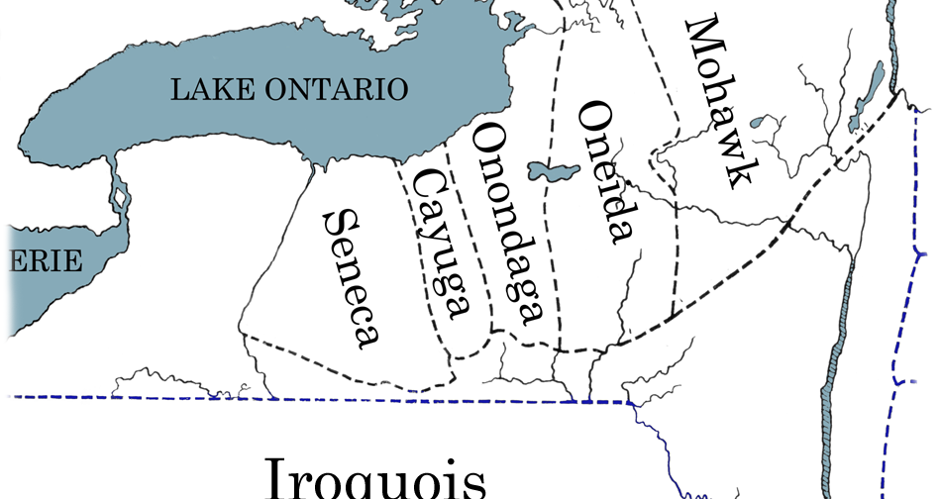
WHERE WAS THE IROQUOIS CONFEDERACY?

Slide 8
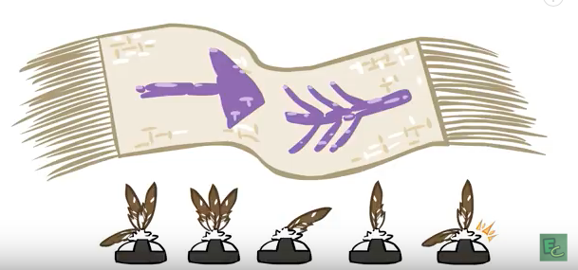
Nations

Slide 9
HOW DID THE IROQUOIS CONFEDERACY BEGIN?
Before the founding of the Confederacy, the nations fought wars against each other.
The history of the Iroquois records that a leader came to the nations with a message of peace and unity. This leader was named Dekanawidah (da-ga-na- wee-duh), the Peacemaker.

Slide 10

HOW DID THE IROQUOIS CONFEDERACY BEGIN?
With the help of Hiawatha, he persuaded each nation to accept the Great Law of Peace.
The Great Law of Peace established a government — the Iroquois Confederacy — that allowed the nations to work together and respect each other.
The Great Law of Peace established an alliance
among the member nations of the Iroquois Confederacy

Slide 11
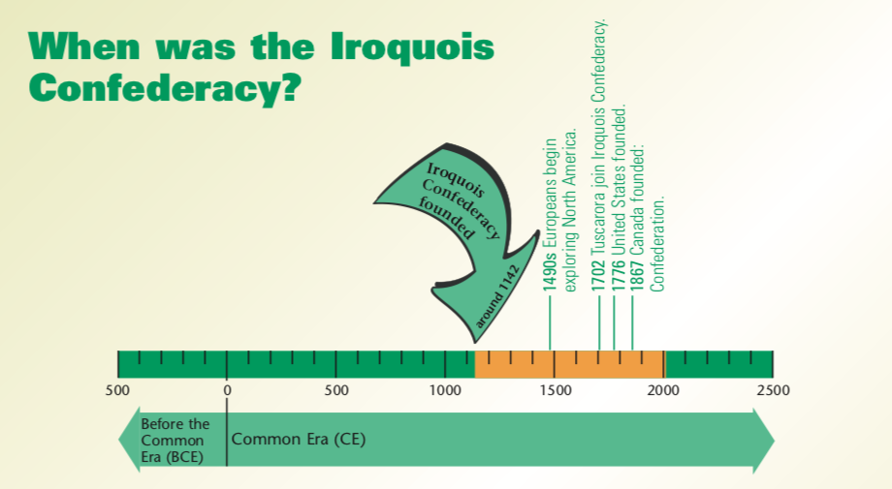

Slide 12
WHAT IS ORAL HISTORY?
Different peoples have different ways of recording their past. The Haudenosaunee traditionally recounted their past in spoken, or oral, records. They had memory keepers who carefully learned and maintained these records from generation to generation.

Slide 13
WHAT IS ORAL HISTORY?
Oral history records that the Seneca were the last of the original five nations to join the Confederacy, and that this happened just after a total eclipse of the sun.
Using astronomical data, researchers examined when solar eclipses occurred in the past. They consulted the oral record for a list of the Confederacy’s leaders, and estimated the span of time the list represented. Then they matched data about angles of the earth and sun with descriptions from the oral record about the historic eclipse. When they put all the pieces of evidence together, they suggested that the first five nations of the Confederacy completed their alliance shortly after a solar eclipse on August 31, 1142.

Slide 14
HOW DID THE IROQUOIS LIVE?
Clans
The Peacemaker established clans within the nations of the Iroquois Confederacy. The clan system united the nations and ensured peace among them. They are still an important part of the identity of Iroquois people today.
Clans were named for one of nine air, water or land animals. With one exception, each clan formed part of at least two nations, and three clans formed part of every nation.
Notes:
I understand the role of clans in the Iroquois Confederacy

Slide 15
HOW DID THE IROQUOIS LIVE?
The Peacemaker set up Iroquois society as matrilineal. This meant clan members traced their family history and ancestors through their mothers. Each clan was made up of a group of families that had a common female ancestor. When people married, the husband moved into his wife’s longhouse. When a child was born, he or she became part of the mother’s clan.

Slide 16
HOW DID THE IROQUOIS LIVE?
Members of the same clan were considered family members. So, they always extended hospitality to each other, even if they came from different nations. Also, people of the same clan did not marry each other.
Within each nation, members of the same clan lived together in a longhouse.
Notes:
I understand the role of the longhouse in the Iroquois Confederacy

Slide 17
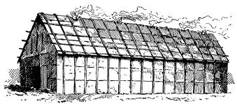
The longhouse
Within each member nation, the Iroquois lived in settlements made up of several longhouses. Longhouses were large, open dwellings where many families of the same clan lived together: grandparents, parents, aunts, uncles, sons, daughters and cousins.
Longhouses were made with a wooden-pole framework covered in bark.
If a clan grew, how do you think the longhouse grew?

Slide 18
The LONGHOUSE
The longhouse was an important place in the government of the Iroquois. It was where men and women met in separate groups to discuss issues and events, and to advise their leaders. People were expected to attend these discussions, because the consensus — or agreement — of the group was crucial. By discussing issues, people came to understand how different choices would affect the group, and came to one mind about the best way forward.

Slide 19
WHAT WAS THE SOCIAL STRUCTURE OF IROQUOIS SOCIETY?
Notes:
I can explain the roles of men and women in the Iroquois Confederacy

Slide 20
A DECISION FOR THE IROQUOIS GRAND COUNCIL
STORY IN TEXTBOOK
Part 1: Page 93
Part 2: Pages 98-100
Part 3: Page 104

Slide 21
WHO’S WHO IN THE IROQUOIS CONFEDERACY?
CHILDREN
Children were often around and listening when adults held discussions. Discussions were part of daily life in a longhouse. Children grew up hearing about issues and learning how decisions were made.
Both women and men had important positions in the Iroquois Confederacy, so girls and boys knew they too would have important roles when they grew up.

Slide 22
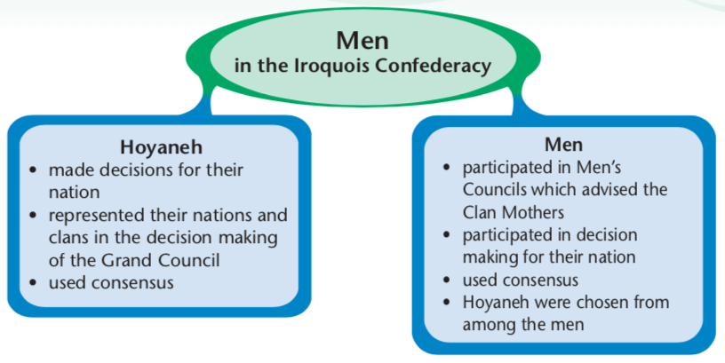
WHO’S WHO IN THE IROQUOIS CONFEDERACY?
MEN
Men had two ways to make their voices heard: as Hoyaneh and through Men’s Councils.

Slide 23
WHO’S WHO IN THE IROQUOIS CONFEDERACY?
MEN
Hoyaneh were the male leaders of each nation of the Iroquois Confederacy. Hoyaneh means “Caretakers of the Peace.” Today we call them chiefs.
The Hoyaneh were chosen and advised by their Clan Mothers. Each nation had several Hoyaneh. Most of the time, they met to make decisions for their nation — decisions about whether to expand or move a village, for example. They used consensus to arrive at the best way forward.
The Hoyaneh also represented their nation at meetings of the Grand Council.

Slide 24
WHO’S WHO IN THE IROQUOIS CONFEDERACY?
MEN
Men’s Councils included all the men in a clan. They met and came to consensus on issues. They, like the women of clans, advised the Clan Mothers.

Slide 25
WHO’S WHO IN THE IROQUOIS CONFEDERACY?
MEN
At the Grand Council, the Hoyaneh wore distinct headdresses that identified them with their nation. In the Iroquois Confederacy, each nation was represented by its own Hoyaneh.
How did this show respect for the diversity of the Confederacy’s member nations?

Slide 26
WHO’S WHO IN THE IROQUOIS CONFEDERACY?
MEN
At the Grand Council, the Hoyaneh wore distinct headdresses that identified them with their nation. In the Iroquois Confederacy, each nation was represented by its own Hoyaneh.

Slide 27
WHO’S WHO IN THE IROQUOIS CONFEDERACY?
MEN
At the Grand Council, the Hoyaneh wore distinct headdresses that identified them with their nation. In the Iroquois Confederacy, each nation was represented by its own Hoyaneh.

Slide 28
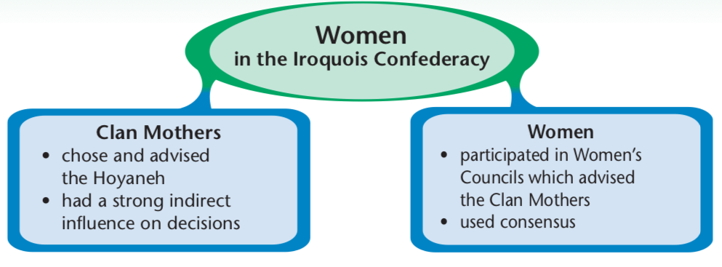
WHO’S WHO IN THE IROQUOIS CONFEDERACY?
WOMEN
Women had two ways to make their voices heard: as Clan Mothers and through Women’s Councils.

Slide 29
WHO’S WHO IN THE IROQUOIS CONFEDERACY?
WOMEN
Clan Mothers were usually the oldest and most respected women in their clans. The title was hereditary and passed on to the woman relative that was thought to be best suited for the position.
Clan Mothers were responsible for their clan’s welfare and for maintaining harmony and balance within the clans and nations.
They selected the Hoyaneh, the male leaders of the Iroquois Confederacy. The Great Law of Peace said the Hoyaneh had to put the needs of their people first. The Clan Mothers could replace Hoyaneh who failed to do this.

Slide 30
WHO’S WHO IN THE IROQUOIS CONFEDERACY?
WOMEN
Within each clan, Women’s Councils and Men’s Councils advised the Clan Mothers. The Clan Mothers in turn advised their Hoyaneh of the people’s position on issues.
How did this process ensure that both men and women had a voice in their government?

Slide 31
WHO’S WHO IN THE IROQUOIS CONFEDERACY?
WOMEN
Women’s Councils developed positions on important issues. Women who were not Clan Mothers took part in councils. Through consensus, they advised the Clan Mothers.

Slide 32
IROQUOIS RIGHTS AND RESPONSIBILITIES
Women’s Rights and Responsibilities
As Clan Mothers:
Knowing and keeping the Great Law of Peace
Promoting the welfare of their clan
Seeking the advice of the Women’s Council and the Men’s Council of their clan
Choosing and advising the Hoyaneh
In Women’s Councils:
  Building a consensus on issues
  Advising the Clan Mothers

Slide 33
IROQUOIS RIGHTS AND RESPONSIBILITIES
Men’s Rights and Responsibilities
As Hoyaneh:
Knowing and keeping the Great Law of Peace
Knowing and fulfilling their role in ceremonies and the Grand Council
Listening to the advice of the Clan Mothers
Thinking of what’s best for their people now and in the future
Building a consensus on issues
Being honest and kindhearted
Being able to withstand criticism
In Men’s Councils:
Building a consensus on issues
Advising the Clan Mothers

Slide 34
WHAT OPPORTUNITIES DID IROQUOIS PEOPLE HAVE TO PARTICIPATE IN DECISION MAKING?
Notes:
I can explain the rights and responsibilities of men and women in the government of the Iroquois Confederacy.

Slide 35
THE GRAND COUNCIL
The Grand Council met to discuss issues that affected the whole Iroquois Confederacy, such as peace treaties, trade agreements, and decisions to go to war.
The Grand Council was made up of the Hoyaneh from each nation — 50 in all. Although they rarely spoke at Grand Council meetings, all Iroquois people — men and women — had ways to make their voices heard in the decision making of the Grand Council. Through the Women’s Councils and Men’s Councils of their clans, they advised the Clan Mothers of their positions on issues. The Clan Mothers, in turn, chose and advised the Hoyaneh. If a Hoyaneh didn’t carefully consider the advice of his Clan Mother, the Clan Mother warned him. After the third warning, she removed him and chose someone else.

Slide 36
THE GRAND COUNCIL
To make a decision, the Grand Council discussed issues in a set order. Council decisions had to be unanimous, so the Grand Council always worked towards consensus. This is the way decisions about traditional and cultural matters are made by the Iroquois today.
The Grand Council used consensus to make decisions.
What advantages did this process have as a way to make decisions?
What disadvantages might it have?

Slide 37
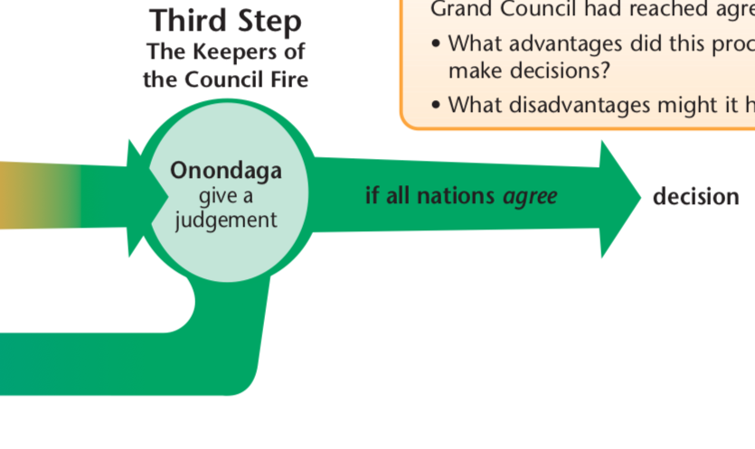
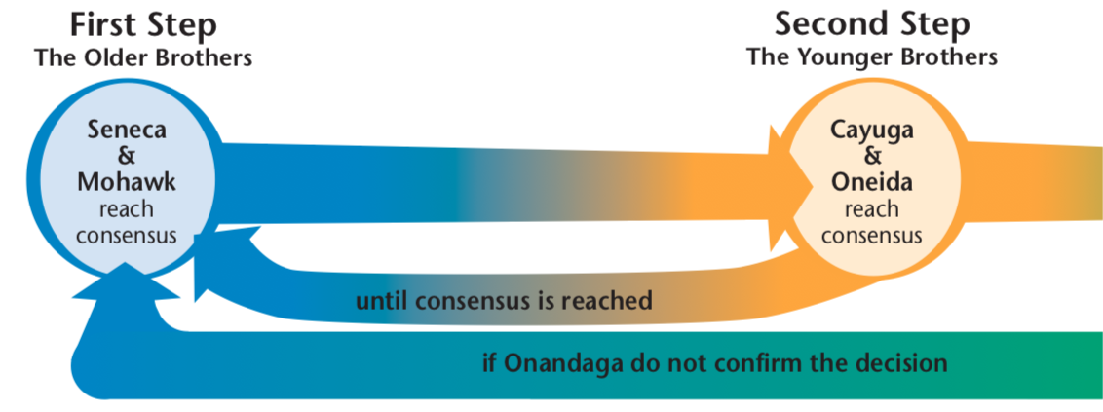
THE GRAND COUNCIL
The Tuscarora, who joined the Confederacy in 1702, are considered part of the younger brothers and speak through the Oneidas in council.

Slide 38
THE IROQUOIS CONFEDERACY
Within each clan and nation, councils of men and women discussed issues and advised the Clan Mothers. The Clan Mothers chose the Hoyaneh to represent their people.
Within each nation, the Hoyaneh formed a council for that nation. This council made decisions that helped its nation function well, such as sharing resources and locating settlements.

Slide 39
THE IROQUOIS CONFEDERACY
The Hoyaneh from each nation represented their people on the Grand Council. The number of Hoyaneh for each nation was established by the Peacemaker.
The Grand Council met when a member nation called for a meeting. The role of the Hoyaneh at Grand Council meetings was to represent the people of their clan and nation. The Clan Mothers advised the Hoyaneh and attended Grand Council meetings to make sure their Hoyaneh fulfilled their role as representatives.

Slide 40
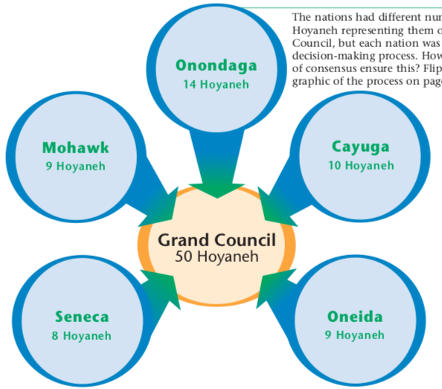

Slide 41
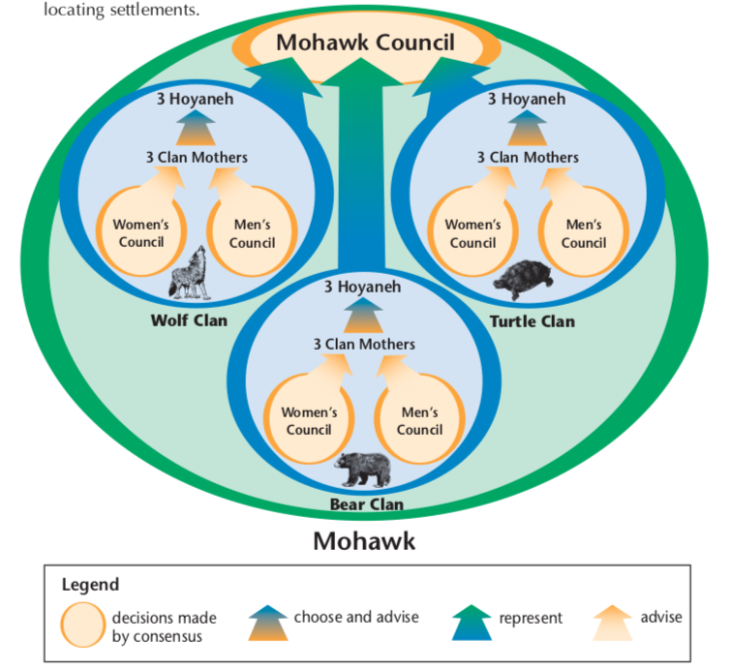
Example

Slide 42
WAMPUM
Among the Iroquois, wampum beads made from shells are woven into patterned strings or belts that record important events, ideas, contracts, pledges or treaties among nations. When Europeans began to arrive in North America, the Iroquois negotiated and concluded agreements with the newcomers and presented them with records of the agreements in wampum. Wampum strings and belts were used at councils and in ceremonies of the Iroquois, and still are.

Slide 43
The Hiawatha Wampum Belt
This wampum belt records the structure and principles of the Iroquois Confederacy. Each of the figures on the belt represents one of the original five nations of the Confederacy, in their geographic order. The Tuscarora are not represented by a symbol on the Hiawatha Wampum belt because they joined the Iroquois Confederacy many years after it was founded.

Slide 44
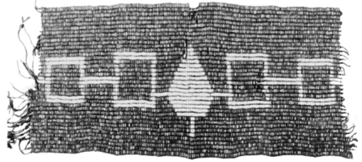
The Hiawatha Wampum Belt
The white line that joins the nations symbolizes the path of peace. It extends out from both sides of the belt. This invites other nations to follow the path of peace, accept the Great Law of Peace, and take shelter under the Tree of Peace.

Slide 45
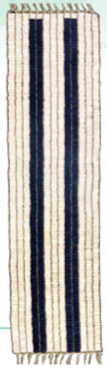
GUSWENTAH:
TWO ROW WAMPUM TREAY
When the Iroquois first encountered Europeans, they discovered people with very different ways and values from their own. The Iroquois proposed a peace treaty — the Two Row Wampum Treaty — based on three values: friendship, peace and mutual respect. Each of the white lines in the Two Row Wampum Treaty represents one of these values. The Two Row Wampum Treaty defines the relationship between the sovereign nations who agree to the treaty.

Slide 46
WHAT ARE THE IDEAS BEHIND THE IROQUOIS CONFEDERACY?

Slide 47
THE TREE OF PEACE
The Iroquois Confederacy united five, and eventually six, separate nations in peace. The Peacemaker used the Tree of Peace, a white pine, to symbolize the peace established by the Confederacy.

Slide 48
REVIEW
WHAT IS THE STRUCTURE OF SOCIETY?
• There were originally five, and later six, separate Iroquois Nations. Each has its own language and its own council.
• Each nation has specific clans which are extended families of the same clan of other nations.
• Families are connected through the women’s lines.
• Extended families used to live in longhouses.

Slide 49
REVIEW
What rights and responsibilities do members of the society have?
• All members of society are expected to follow the Great Law of Peace.
• Clan mothers listen to their clan members, give advice and choose their Hoyaneh.
• The Hoyaneh listen to their Clan Mothers and are responsible for representing their own clan and nation. They are also responsible for helping make Grand Council decisions.
• Each member nation of the Confederacy is equally important on the council.

Slide 50
REVIEW
What is the procedure for making government decisions?
• The Grand Council is composed of 50 Hoyaneh representing their clans
and nations.
• The Grand Council makes decisions affecting the entire Confederacy.
• The member nations hold discussions in a set order.
• The Hoyaneh from each nation must reach consensus.
• Decisions are agreed on only after consensus from the entire Council.
• Decisions were traditionally recorded with wampum belts.

Slide 51
REVIEW
How do members of society influence government decisions?
• Clan Mothers choose the Hoyaneh and ensure they adequately represent their people.
• Both men’s and and women’s voices are heard through the Men’s Councils and Women’s Councils that advise the Clan Mothers. The Clan Mothers advise the Hoyaneh.

